Slide 1

Contents
  Testing Overview
  Guidelines on Sample Selection
    Determination of sample size
    Sample Size Table
    Key Points to Consider

Slide 2
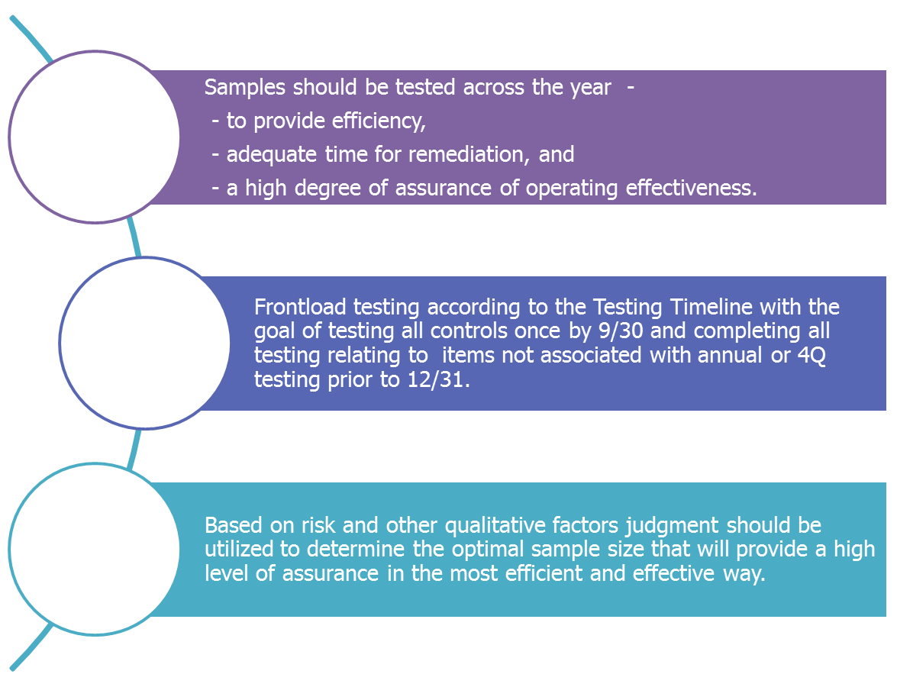
SOX/MAR - Testing Overview
Samples
representation
Timelines
Use of Judgment

Slide 3
Guidelines on Sample Selection

Slide 4
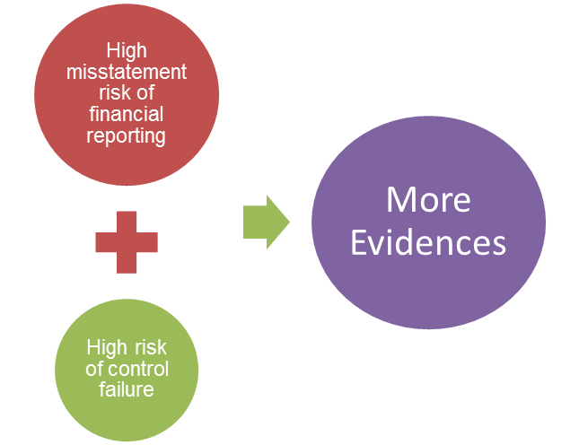
SOX/MAR – Determination of Sample Size
  In order to determine the appropriate number of samples to be tested, one should consider the characteristics of the financial reporting elements to which the controls relate and the characteristics of the controls themselves. It is the relationship between misstatement risk of financial reporting and risk of control failure which together determines the sample size required to be tested for a higher level of assurance.
Less misstatement risk of financial reporting
Less Evidences
Less risk of control failure
Contd…

Slide 5
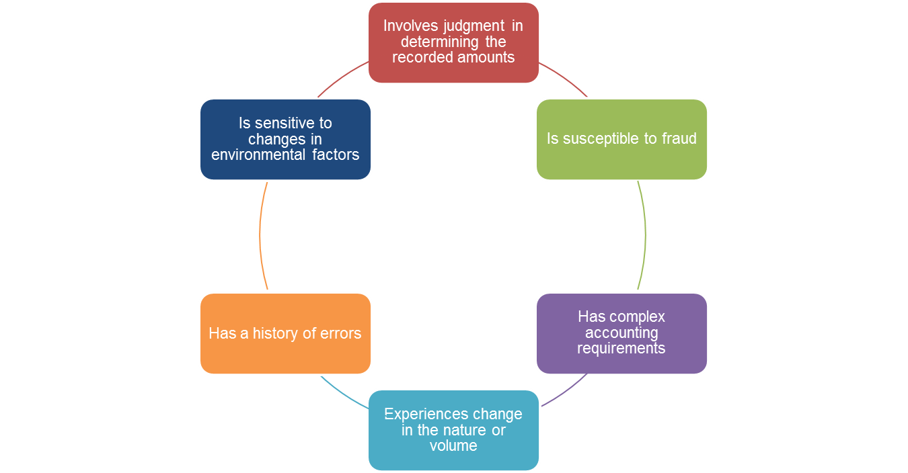

SOX/MAR – Determination of Sample Size
I. Misstatement Risk Of Financial Reporting
These items drive the overall risk relating to the financial statement line item being controlled and also drive the level of sampling that is necessary. If these items are prevalent for a particular account or process, there would be an elevated risk of misstatement which would require more samples to test for greater assurance.
Contd…

Slide 6
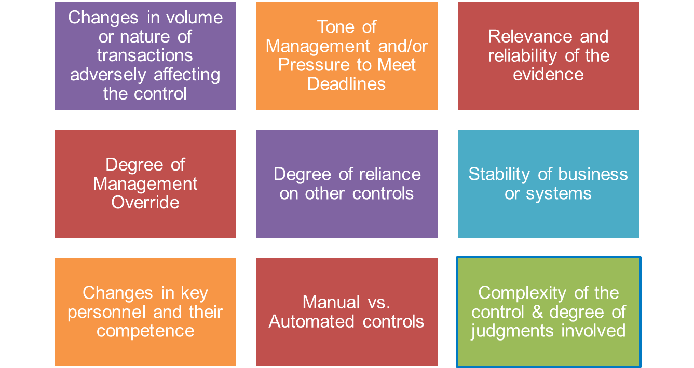
SOX/MAR – Determination of Sample Size
II. Risk Of Control Failure
Factors effecting the likelihood that a control might fail to operate effectively
Contd…

Slide 7
SOX/MAR – Determination of Sample Size
Sample Size Reference Table
Frequency of Control | Sample Size (Note 1) |  |  | Assumed Number of Control Occurrences per Annum (Note 2)
 | Low | Medium | High
Annual | 1 | 1 | 1 | 1
Quarterly | 2 | 2 | 2 | 4
Monthly | 2-5 |  |  | 12
Weekly | 5 | 10 | 15 | 52
Daily | 20 | 30 | 40 | 250
Multiple Times a Day | 25 | 45 | 60 | Over 250
Automated Controls | Test one application of each programmed control for each type of transaction if supported by effective IT General Controls that have been tested.
Note 1 | The ranges in the table above are based on the population of individual instances where the control is expected to operate. With the exception of multiple times a day, the ranges assume the control being tested operates in only one instance in each of the applicable periods,
Note 2 | Refers to the number of occurrences of the control and will ordinarily be applied to tests involving reperformance and/or examination of evidence.
Contd…

Slide 8
Examples - Sample Selection
  Multiple Instances - A company has a control that operates on a monthly basis in a large number of instances (i.e. one individual performs monthly bank reconciliations for all 50 of the company's bank accounts).
    In the example, the first step is to convert the information given into the population of instances of the control's operation on an annual basis, in this case 12 months X 50 bank reconciliations or 600. The next step is to select the period in the table whose population corresponds to the population we are testing. In this case, 600 would represent a large population and therefore we would select a sample size using the range for controls operating multiple times a day (i.e., low of 25, mid of 45, and high of 60).
    If for the example above, we had 15 reconciliations instead of 50, the total annual population would be 180. In this case, considering that the frequency is greater than 52 and lower than 250, we may determine an appropriate sample size based on the frequency of the control in relation to our controls test guidance sample sizes (i.e., low of 15, mid of 22 and high of 29).
Contd…

Slide 9
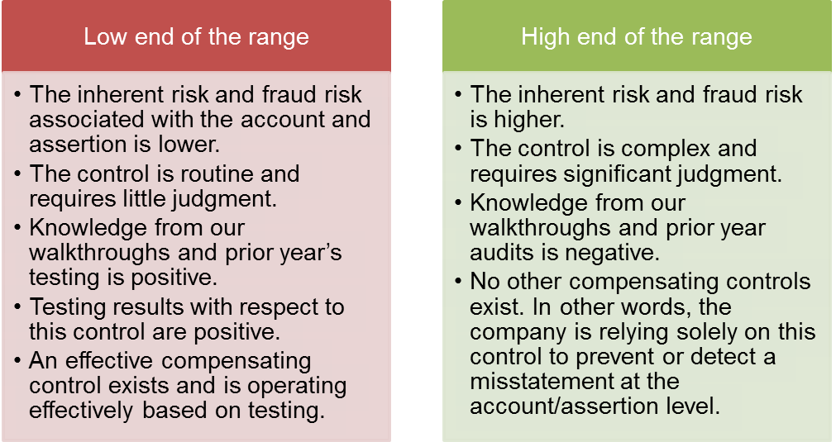
Examples – Sample Selection
  Selection of samples at a low or high end of the range depends on one or a combination of the following factors -
Select 25 samples
(for a multiple times a day control)
Select 45 if falls in between
Select 60 samples
(for a multiple times a day control)

Slide 10
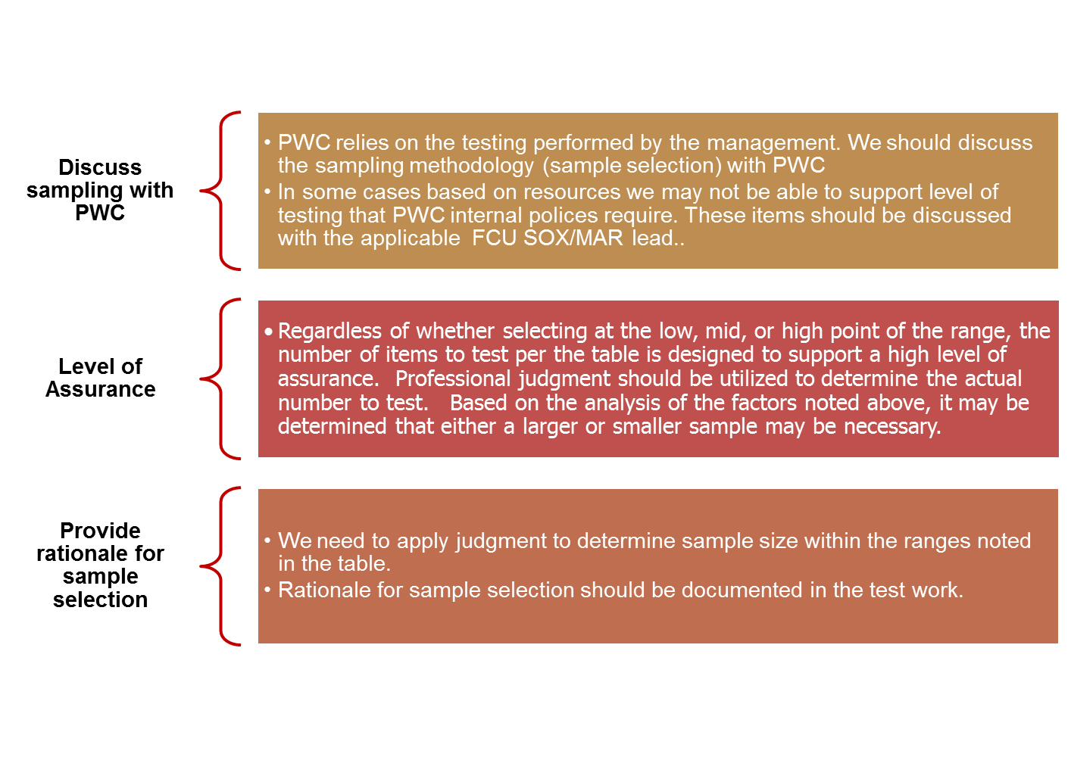
SOX/MAR – Determination of Sample Size
Key points to consider for appropriate sample selection with a clear objective of providing greater assurance and higher reliance by external auditors -
Contd…

Slide 11
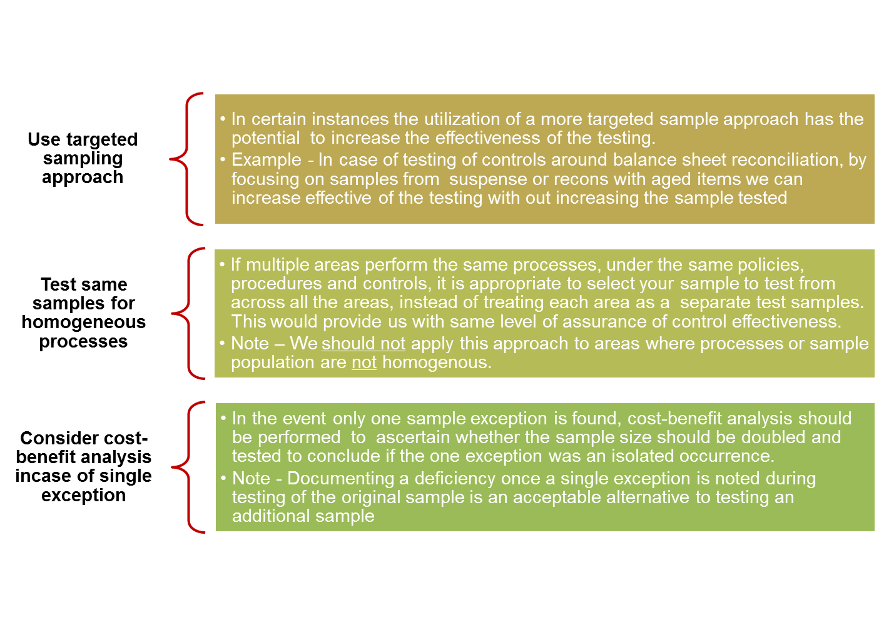
SOX/MAR – Determination of Sample Size

